Slide 1
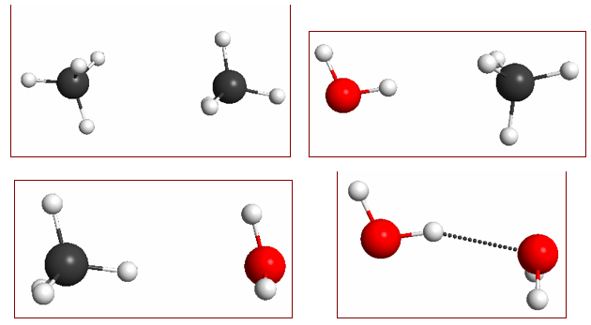


Low-Dimensional Machine Learning Potentials for Molecular Systems
Sahil Shah
EPFL Supervisors: Prof. Michele Ceriotti & Dr. Max Veit
Imperial College London Supervisor: Prof. Sophia Yaliraki
Notes:
I’m presenting my research on Low-Dimensional Machine Learning Potentials for Molecular Systems. The potentials are low-dimensional as I produced 1D pair potentials from 6D PES. In this project, methane dimers were selected as a test system for a new method of producing pair potentials.

Slide 2
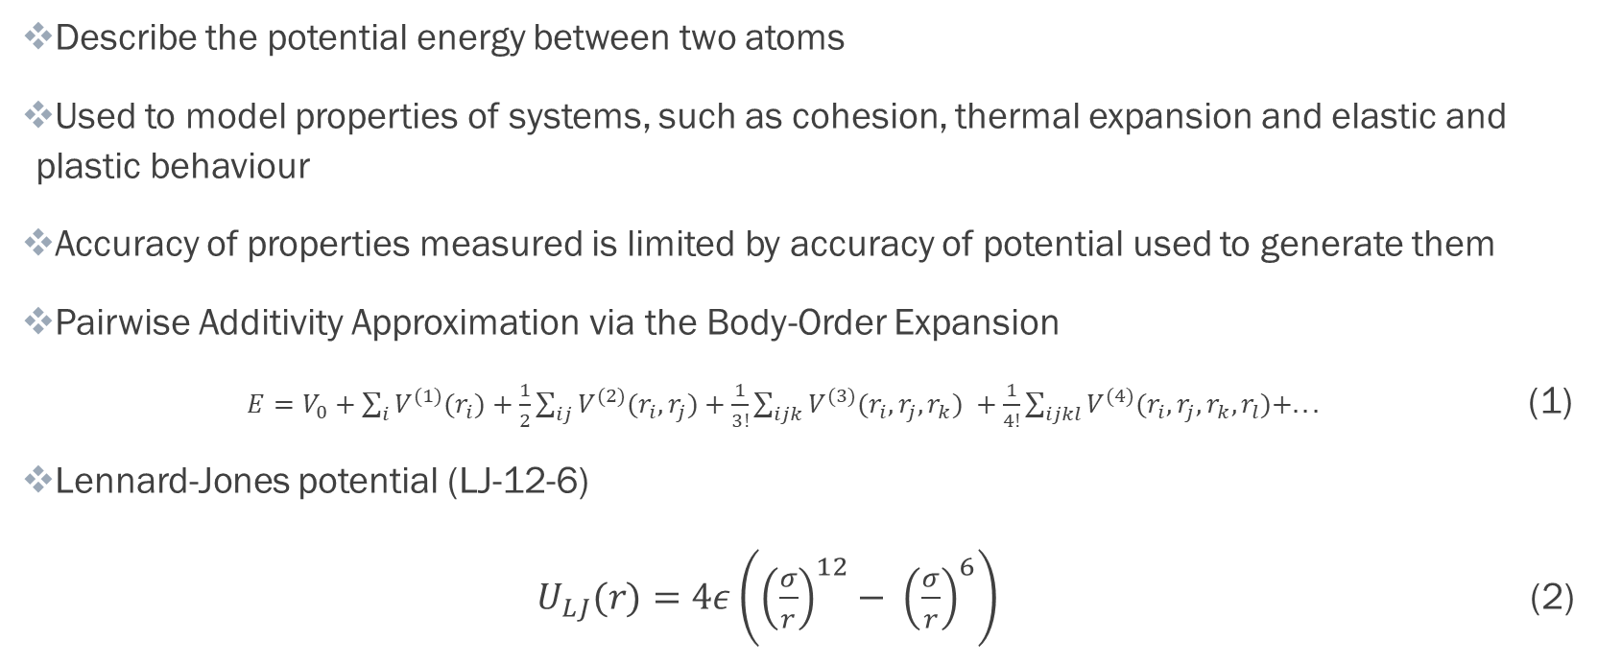
Pair Potentials
Describe the potential energy between two atoms
Used to model properties of systems, such as cohesion, thermal expansion and elastic and plastic behaviour
Accuracy of properties measured is limited by accuracy of potential used to generate them
Pairwise Additivity Approximation via the Body-Order Expansion
$E=V_{0}+\sum_{i}{V^{(1)}(r_{i})+\frac{1}{2}\sum_{ij}{V^{(2)}(r_{i},r_{j})+\frac{1}{3!}\sum_{ijk}{V^{(3)}(r_{i},r_{j},r_{k}) }}}+\frac{1}{4!}\sum_{ijkl}{V^{(4)}(r_{i},r_{j},r_{k},r_{l})+... }$ (1)
Lennard-Jones potential (LJ-12-6)
$U_{LJ}(r)=4ε\left({\left(\frac{σ}{r}\right)}^{12}− {\left(\frac{σ}{r}\right)}^{6}\right)$ (2)
Notes:
Interatomic potentials in general describe the potential energy interaction between two or more atoms. They can be used to help model and predict properties of systems, such as cohesion, thermal expansion and elastic and plastic behaviour of materials. The accuracy of properties of a system obtained from molecular simulations is limited by the accuracy of the potential used to model the system. Potentials have generally been notoriously difficult to compute highly accurately.
In Equation 1, the total energy can be written as a sum of atomic potential energies (the V_1 terms), pair potential energies (V_2 terms) and higher-body-order corrections in the Body-Order Expansion. The constant V_0 is usually set to zero. Therefore, by neglecting higher-body-order corrections and subtracting off the atomic potential energies, we get an approximation for the total energy through the sum of pair potentials. This is known as the pairwise additivity approximation. We are still interested in pair potentials, over other potentials, since they are often cheaper to compute than many-body potentials.
Pair potentials have been modelled extensively using the Lennard-Jones potential, which was first developed to model the Equation of State of noble gases. The typical L-J potential is shown in Equation 2, and the power of -6 was chosen for the attractive tail, when the leading term in the dispersion energy followed this relationship, which came from the quantum mechanical solution of the correlation energy of two fluctuating dipoles.

Slide 3


Machine Learning Potentials
Machine Learning Potentials – much more accurate due to greater functional flexibility
Gaussian Process Regression – used to make Gaussian Approximation Potentials (GAPs)
Distance scaling – why might it be a good idea?
Rescaling by powers of -6 and -12, combining to give 12-6 model
Created 4 models – Unscaled Distances, 6th-Power, 12th-Power and 12-6
$$\frac{1}{r^{6}}$$
$$\frac{1}{r^{12}}$$
Notes:
More recently, machine learning potentials have been developed using various techniques such as linear regression and neural networks. These are more accurate than L-J potentials, due to their greater functional flexibility, with many more parameters.
Another popular technique, which was the focus of my project was Gaussian Process Regression to create Gaussian Approximation Potentials (GAP). GAP is not a new concept, but given strong evidence in previous research (a Lennard-Jones potential was fitted using scaled distances), we thought it would be good idea to try fitting to scaled distances to obtain more accurate pair potentials.
Therefore, in this project, the distances were scaled by powers of both -6 and -12, with both models combined to give a 12-6 model. It was hoped that the scaling would lead to improved fits for the 12th-power repulsion and 6th-power attraction for methane dimer potentials.

Slide 4
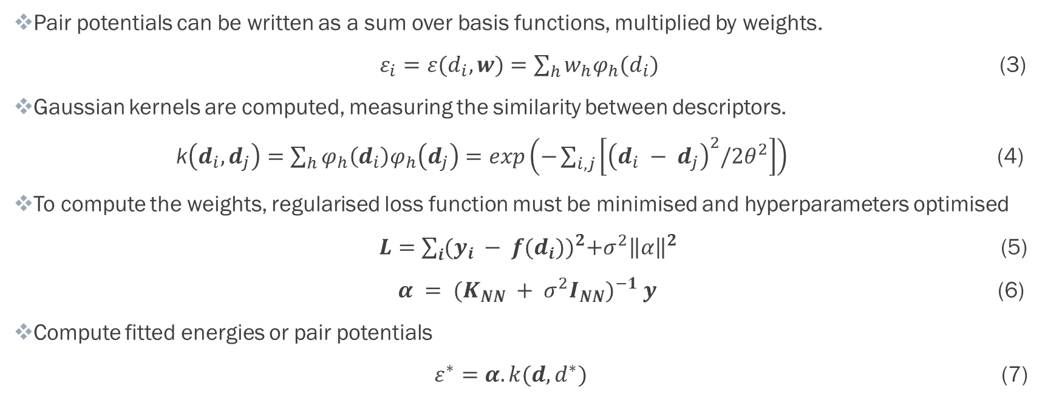
Gaussian Process Regression
Pair potentials can be written as a sum over basis functions, multiplied by weights.
$ε_{i}=ε(d_{i},w)=\sum_{h}{w_{h}φ_{h}(d_{i})}$ (3)
Gaussian kernels are computed, measuring the similarity between descriptors.
k$\left(d_{i},d_{j}\right)=\sum_{h}{φ_{h}\left(d_{i}\right)φ_{h}\left(d_{j}\right)=exp\left(−\sum_{i,j}{\left[{\left(d_{i} − d_{j}\right)}^{2}/2θ^{2}\right]}\right)}$ (4)
To compute the weights, regularised loss function must be minimised and hyperparameters optimised
$L=\sum_{i}{{(y_{i} − f(d_{i}))}^{2}+σ^{2}{\left\|α\right\|}^{2}}$ (5)
$α = {(K_{NN} + σ^{2}I_{NN})}^{−1} y$ (6)
Compute fitted energies or pair potentials
$ε^{∗}=α.k(d,d^{∗})$ (7)
Notes:
Describe Gaussian Process Regression
In linear and kernel methods, each pair potential energy can be written as the sum over basis functions multiplied by their weights, as shown in Equation 3. These basis functions are functions of descriptors, which are transformations of the coordinates between two or more bodies. Therefore, kernel regression was chosen as the technique of choice, since it could capture the non-linear behaviour within a linear fit without having to find a complete basis set to represent the energy.
The product of two basis functions in Equation 3 is equivalent to the kernel and this can be computed using Equation 4, as a similarity measure between descriptors, where the value theta is the length scale parameter.
In order to obtain the optimal fit, the weights, alpha, must be computed by minimising the regularised loss function in Equation 5 and the regulariser hyperparameter, sigma, must be optimised to give the minimum error. In this loss function, y are the dataset energies and f(d_i) are the fitted energies. This can be done computationally, by using Equation 6, where K_NN is the train-train kernel, which has been summed over all columns and rows for each molecule. The regulariser can be optimised using grid search optimisation, using cross-validation, where evenly spaced points are tested to see which regulariser value gives the lowest validation error.
The fitted energies or pair potentials themselves can be computed using Equation 7, where the * indicates a new point. If this new point is from the training dataset, then this produces the fitted total energy, but if it is from the test dataset of pair distances only, then this will give the pair potential energy.

Slide 5
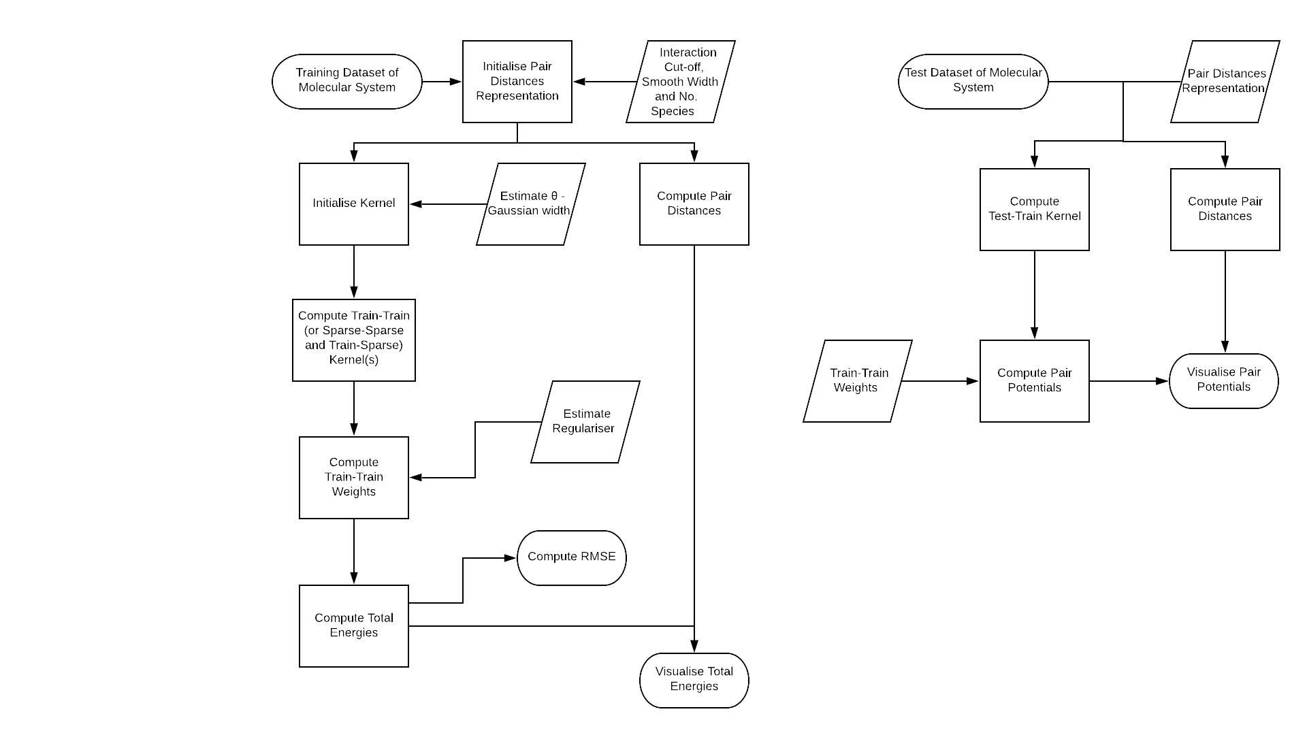
librascal Development
Flowchart describes the process of producing Gaussian Approximation Potentials (GAP)
Most of computational cost comes from computing descriptors and kernels
Pair distances and Gaussian kernels computed in librascal
Distance scaling implemented
Methane dimer dataset chosen to generate GAP
Figure 1 – GAP Flowchart
Notes:
This process can be understood more clearly with the use of a flowchart.
As my supervisor, Dr. Max Veit said in a presentation last year, the majority of the computational cost of computing GAPs in QUIP comes from the computation of descriptors and kernels. Therefore, I wrote some code in librascal to compute pair distances and Gaussian kernels, where it was possible to scale the pair distances by a predefined power.
A methane dimer dataset was chosen to generate C-C, C-H and H-H pair potentials, as the dominant interaction between methane monomers in a dimer is known to be dispersion. The dataset was created by generating a sample of 2418 dimers, taken from a liquid MD simulation using 200 rigid geometry-optimised monomers. The sampling was biased towards shorter distances, since this is where the GAP was desired to be the most accurate. The intermolecular energies were generated using MP2 and were exactly the two-body contribution to the total energies, with one-body energies removed.

Slide 6
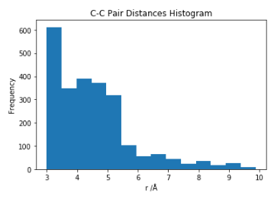
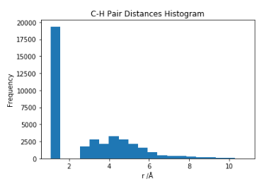
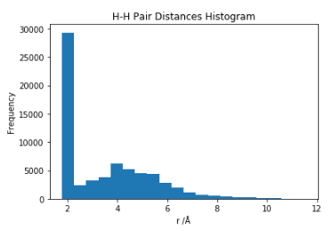
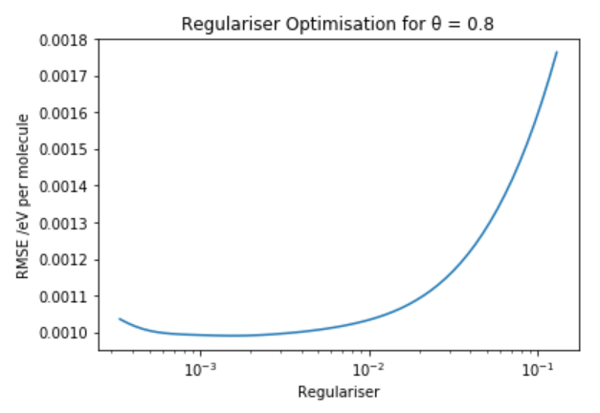
Unscaled Distances Model – Hyperparameter Optimisations
Estimation of length scale parameter at 0.8 Å
Optimisation of regulariser using six-fold cross-validation
Optimal and low regularisers still gave overfitted potentials
A slightly higher regulariser was used of 0.03 with a cross-validation error of 1.15 meV per methane molecule
Figure 2 – Unscaled Distance Optimisations
Notes:
The first model created was the Unscaled Distances model and the first step was to try to optimise the parameters used in creating a GAP fitted using regular unscaled distances.
The length scale parameter was estimated by observing the range over which two distances remained correlated, using both the histograms in Figure 2 and the total potential energy surface. The histograms included all pairs both intramolecular and intermolecular as librascal is unable to differentiate between them. The length scale parameter was estimated to be 0.8 Å. A full optimisation of the length scale parameter would have been too costly for the scale of this project, but a value of 0.8 Å gave the lowest error when compared to other values.
The regulariser was fully optimised, using six-fold cross-validation and produced the plot shown. It was found that optimal and low regularisers still gave overfitted oscillating potentials, so the regulariser was increased, without compromising on the error, to reduce oscillations in the potential. In the end, a slightly higher regulariser of 0.03 was used, which gave a cross-validation error of 1.15 meV.

Slide 7
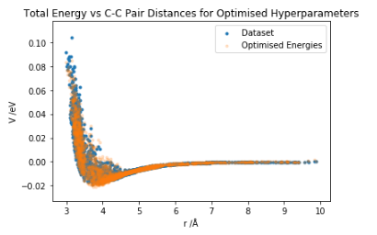
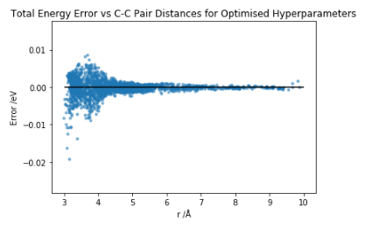
Unscaled Distances Model
Training error of 1.02 meV per methane molecule, lower than the standard deviation of the quantum mechanical energies
librascal unable to differentiate between intramolecular and intermolecular pairs
Larger error at short-range and smaller error at long-range
Error oscillates at long-range
Figure 3 – Total Energy Plots
Notes:
Using the optimised hyperparameters, the potential was trained on the dataset and gave a training error of 1.02 meV, which was lower than the standard deviation of the quantum mechanical energies of 8.77 meV, highlighting the accuracy of the GAP.
Observing the error plot in Figure 3, there is a larger error at short-range and smaller error at long-range. This is to be expected as at short-range there is strong repulsion and higher variance in the energy, leading to a greater error. In the long-range, there are small oscillations, highlighting that a shorter cut-off radius may be required.

Slide 8
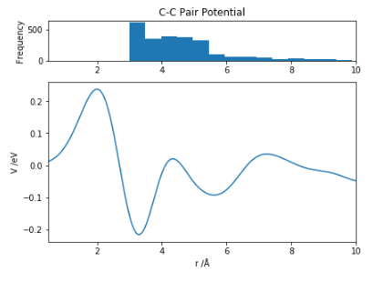
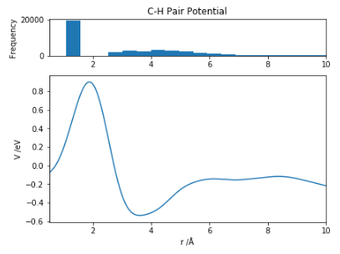
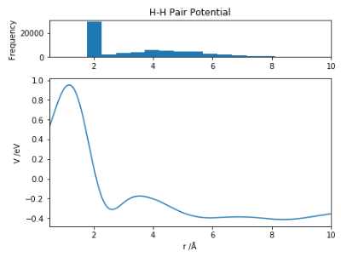
Unscaled Distance Potentials
Potentials oscillate at long-range, shorter cut-off may be required
High amplitudes in the energy scale
Full optimisation of length scale parameter required
Potentials contain repulsive components to total energy at short-range
Figure 4 – Unscaled Distance Potentials
Notes:
Using test datasets of 10,000 incrementally increasing distances for each pair, I generated the pair potentials.
The pair potentials oscillate at longer distances, again suggesting that a shorter cut-off would lead to an improved tail form. They also had high amplitudes in the energy scale, suggesting that a full optimisation of the length scale parameter would be more beneficial to provide a more realistic potential.
The potentials contain mostly repulsive components to the total energy at short-range, shown by the large peaks which act repulsively on pairs beyond the distance corresponding to the peak.
The pair distance histograms were plotted at the top of the figures to show the regions of the potential which are most likely to be reliable, given the concentration of data at those distances.

Slide 9
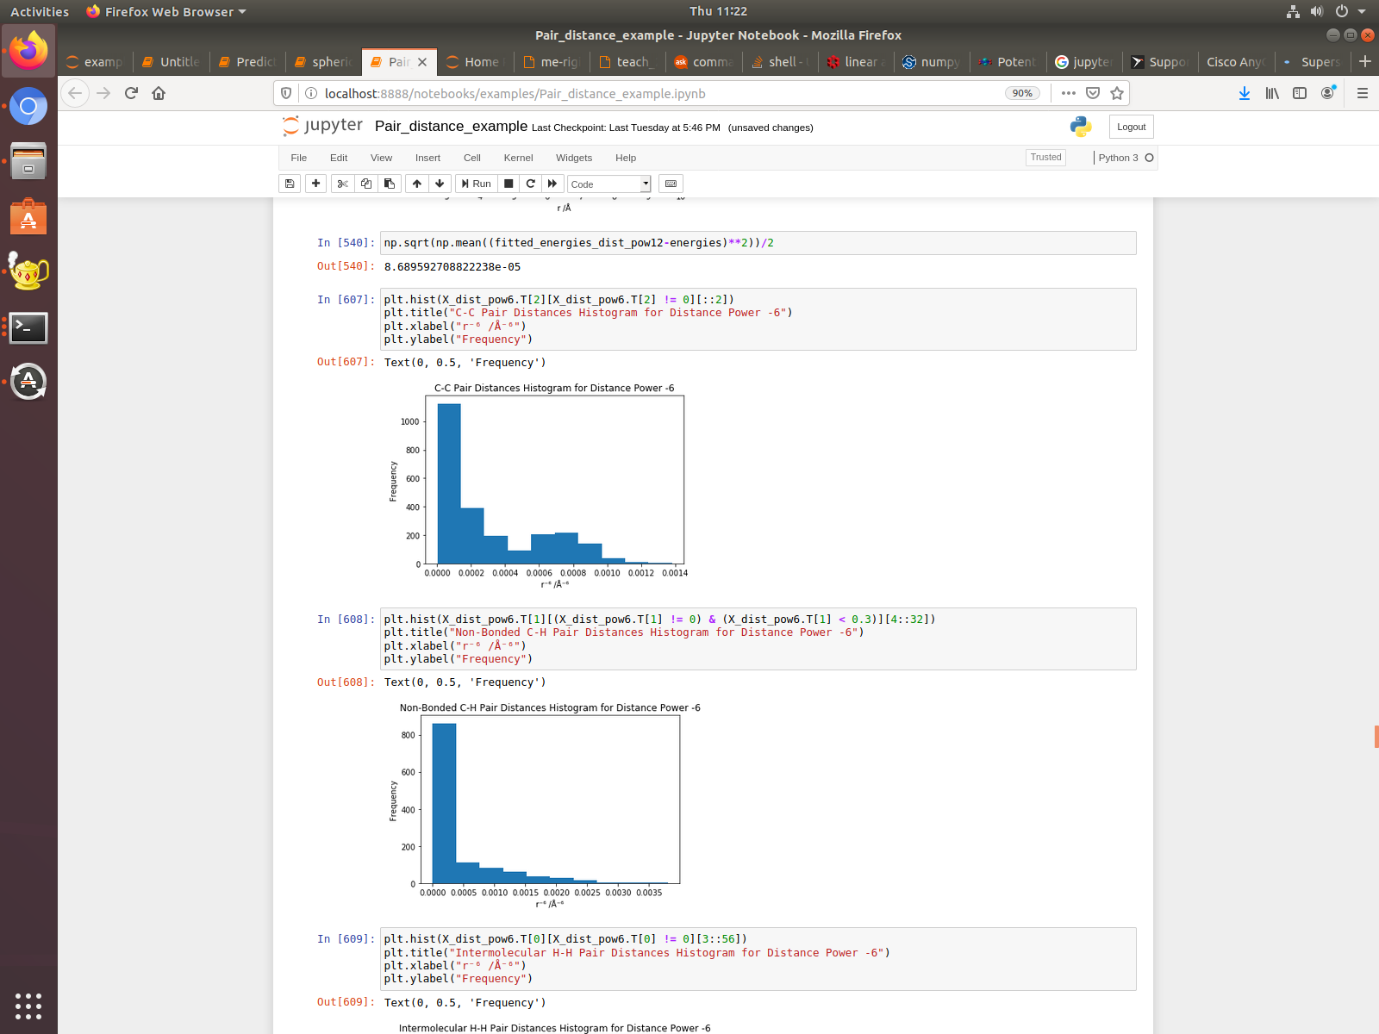
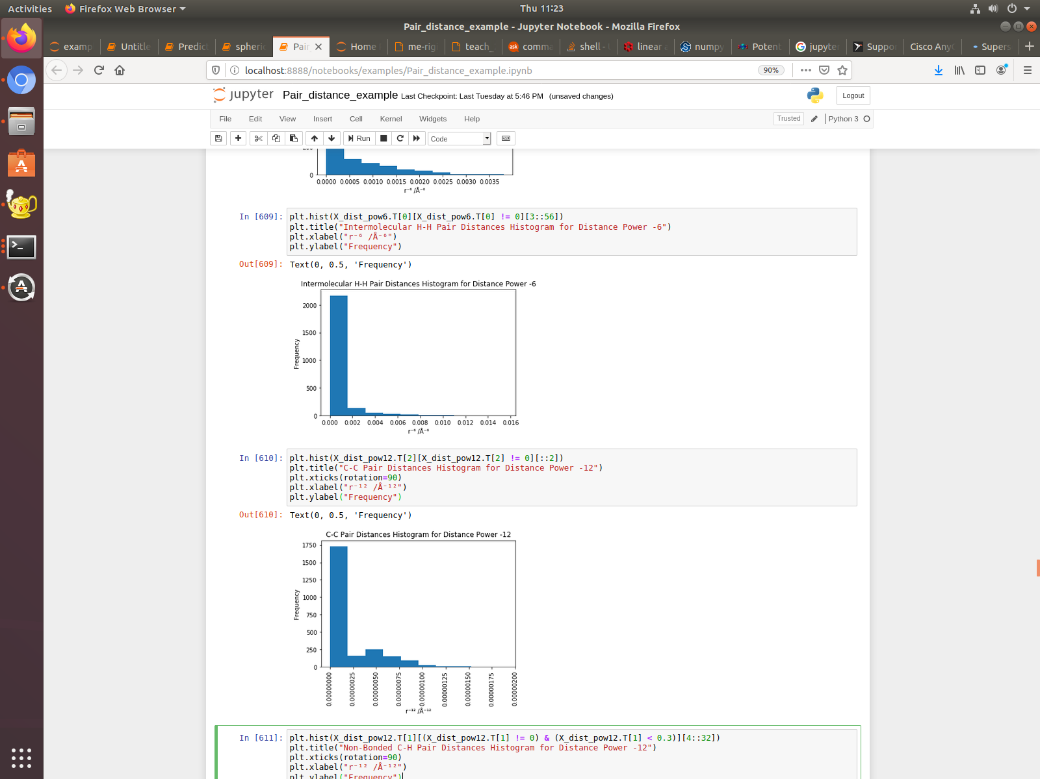
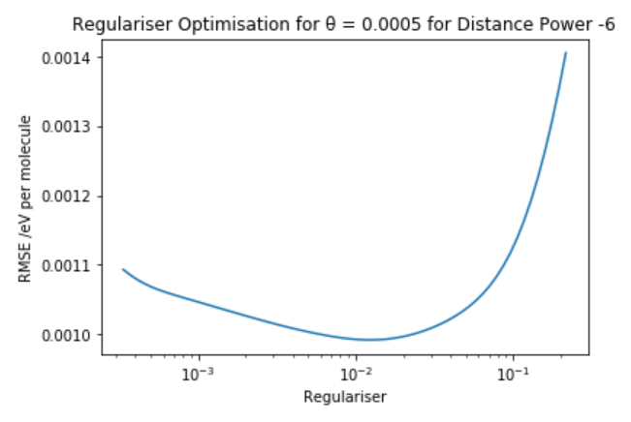
6th-Power Model – Hyperparameter Optimisations
Pair distances scaled by power of -6 in librascal
Estimated length scale parameter at 5x10⁻⁴ Å⁻⁶
Regulariser optimised through six-fold cross-validation
Slightly higher regulariser was chosen at 0.07 with a cross-validation error of 1.07 meV per methane molecule
Figure 5 – 6th-power Optimisations
Notes:
To create a 6th-power model, the pair distances were scaled by a power of -6 in librascal and again the length scale parameter was estimated in the same way as before and it was estimated to be 5x10⁻⁴ Å⁻⁶.
The regulariser was again optimised using cross-validation again. To avoid overfitting, a slightly higher regulariser of 0.07 was chosen and this gave a cross-validation error of 1.07 meV, which was lower than that of the unscaled distances.

Slide 10
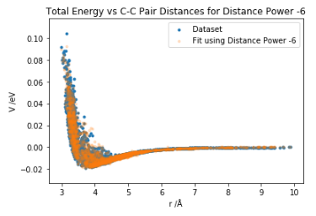
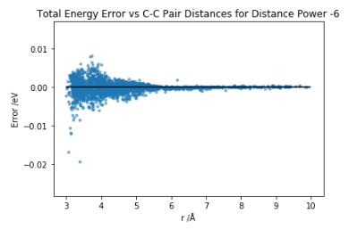
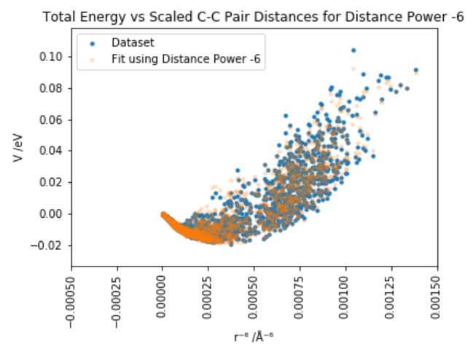
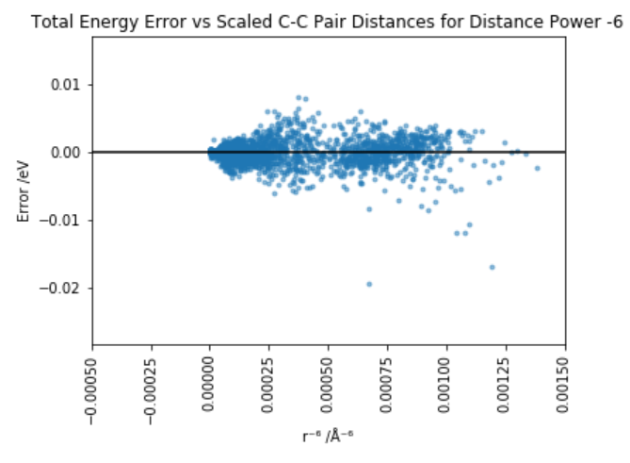
6th-Power Model
Training error of 863 μeV per methane molecule
Smaller error at short-range than unscaled distances fit
Oscillations at long-range removed
Good option for long-range tail of intermolecular interactions
Figure 6 – 6th-power Total Energy Plots
Notes:
The 6th-power model was trained and produced a training error of 863 μeV, showing an improvement on the unscaled distances model in both cross-validation and training errors.
This model has a smaller error at short-range than the unscaled distances fit, showing that the distance scaling has been successful in somewhat removing the short-range error. In addition, the oscillations observed at long-range in the unscaled distances fit have been removed, showing a much more physical 6th-power decay. These results also suggest that the 6th-power rescaling is a good option for fitting the long-range tail of intermolecular interactions, with the short-range potentially taken care of by another model.

Slide 11
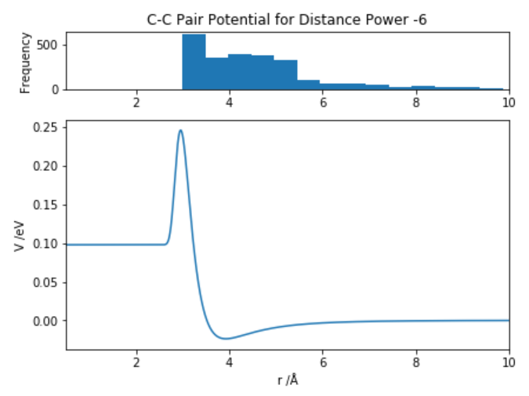
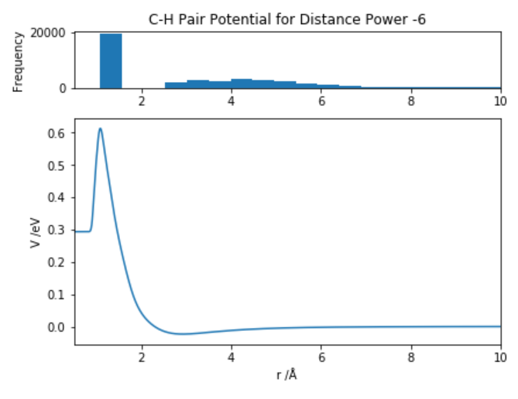
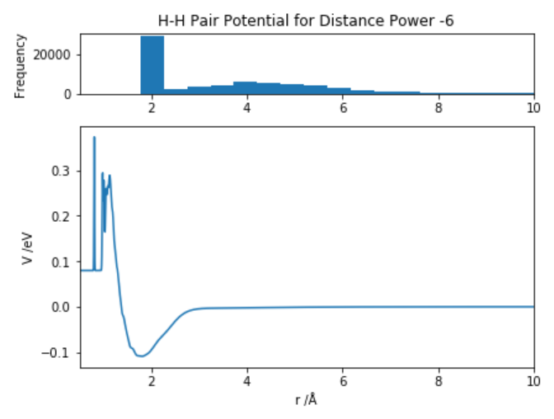
6th-Power Potentials
Residual intramolecular energy removed
All show attractive and repulsive contributions to total energy at long- and short-range
Mostly fairly smooth potentials
Well depths of 23.6 meV, 23.3 meV and 109 meV for the C-C, C-H and H-H potentials
Figure 7 – 6th-power Potentials
Notes:
Using the same test datasets before, the 6th-power potentials were generated. The potentials were found to contain residual intramolecular energy, as the sum of the intramolecular energies and the intermolecular offsets was equal to zero. These intramolecular energies were removed from the potentials.
All the potentials held a reasonable physical form and a 6th-power decay to zero, which therefore demonstrates a huge benefit of fitting to scaled distances without using a shorter cut-off.

Slide 12
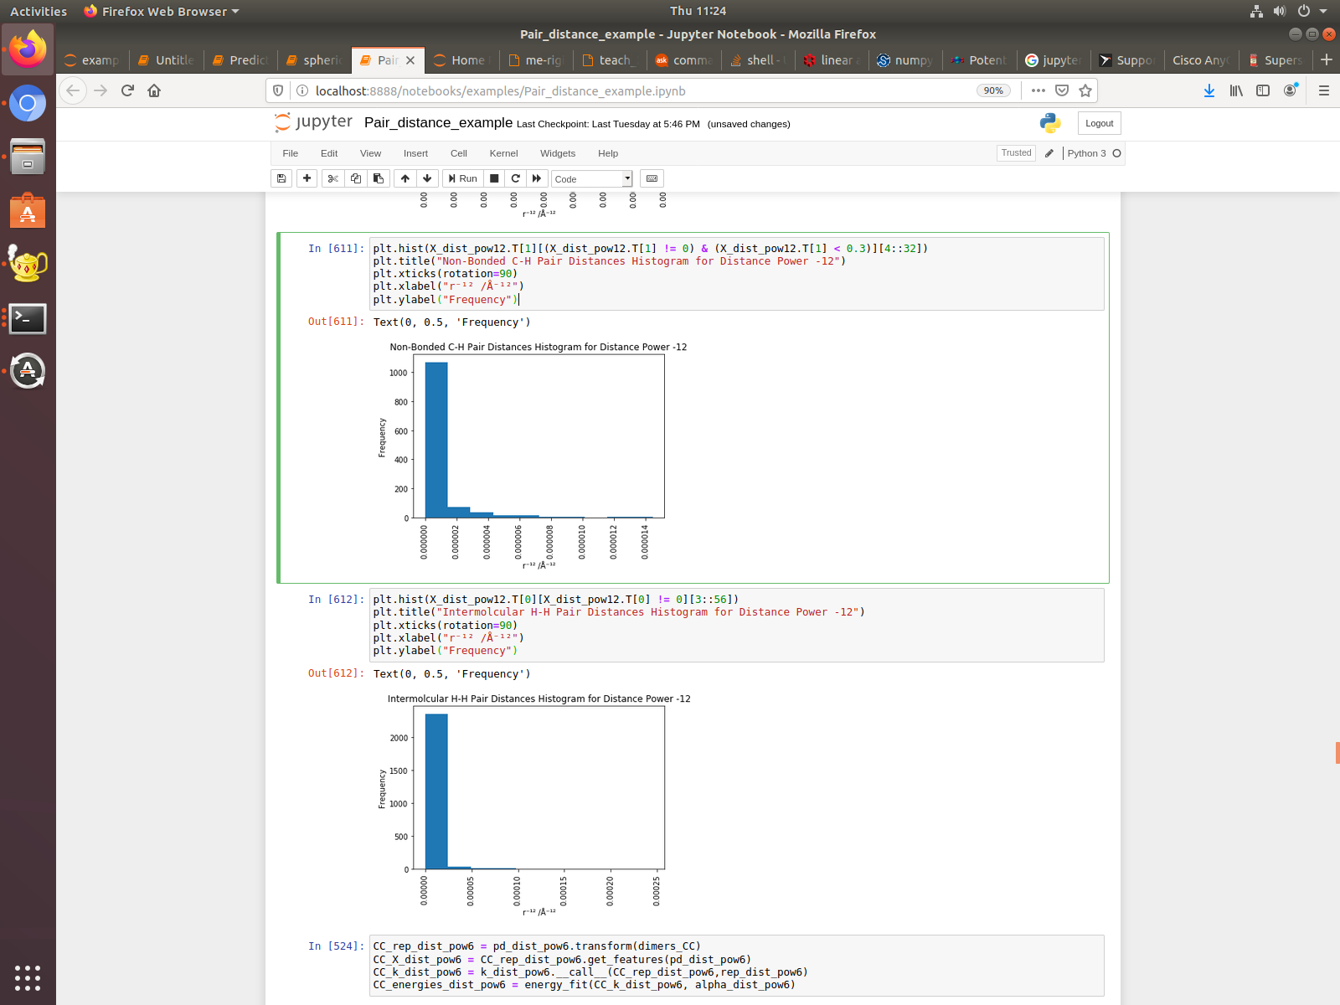
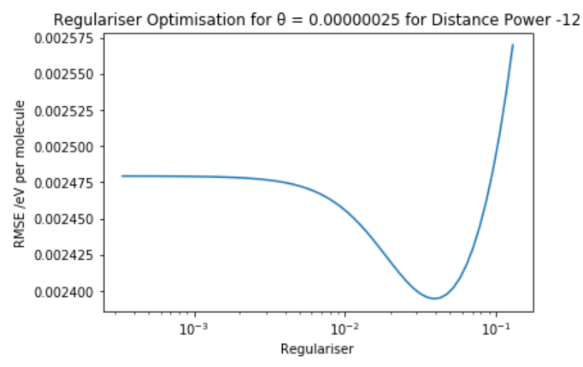
12th-Power Model – Hyperparameter Optimisations
Pair distances scaled by power of -12 in librascal
Estimated length scale parameter at 2.5x10⁻⁷ Å⁻¹²
Regulariser optimised through six-fold cross-validation
Slightly higher regulariser was chosen at 0.06 with a cross-validation error of 2.41 meV per methane molecule
Figure 8 – 12th-power Optimisations
Notes:
To create a 12th-power model, the pair distances were scaled by a power of -12 in librascal and again the length scale parameter was estimated in the same way as before and it was estimated to be 2.5x10⁻⁷ Å⁻¹² .
The regulariser was optimised in the same way and a slightly higher regulariser of 0.06 was chosen with a cross-validation error of 2.41 meV. This cross-validation error was much larger than that of the 6th-power model and the unscaled distances model, implying that this was overfitted, despite being close to the minimum of the optimisation.

Slide 13
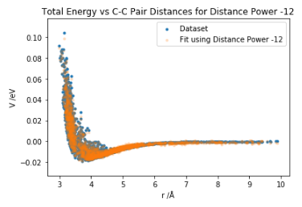
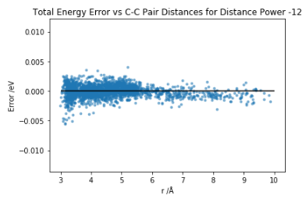
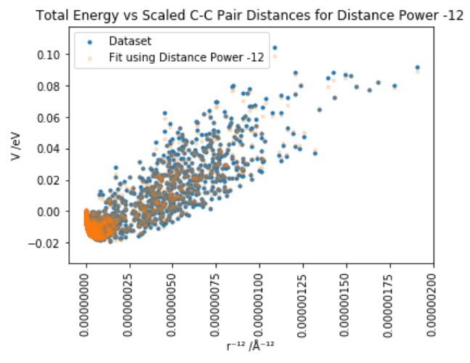
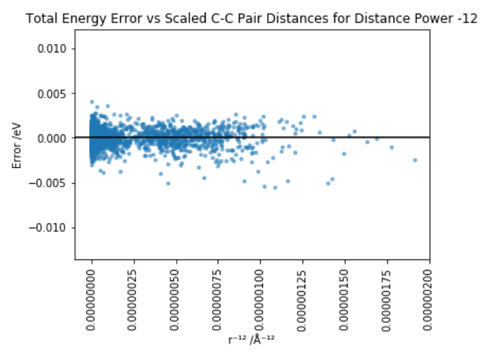
12th-Power Model
Lower training error of 499 μeV per methane molecule
Higher cross-validation error implies overfitting
Bias at long-range, error values consistently negative
Improve with a full optimisation of length scale parameter
Figure 9 – 12th-power Total Energy Plots
Notes:
The 12th-power model was trained and produced a lower error of 499 μeV. However, given the high cross-validation error, this was likely to have been a result of overfitting.
There is also a bias at long-range, with error values being consistently negative beyond 6-7 Å.

Slide 14
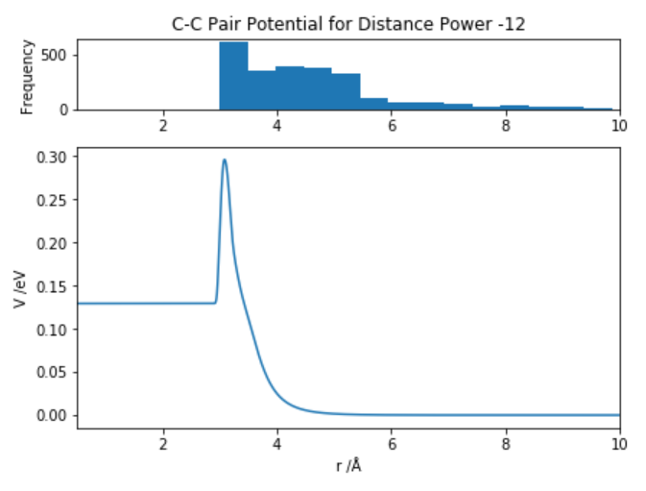
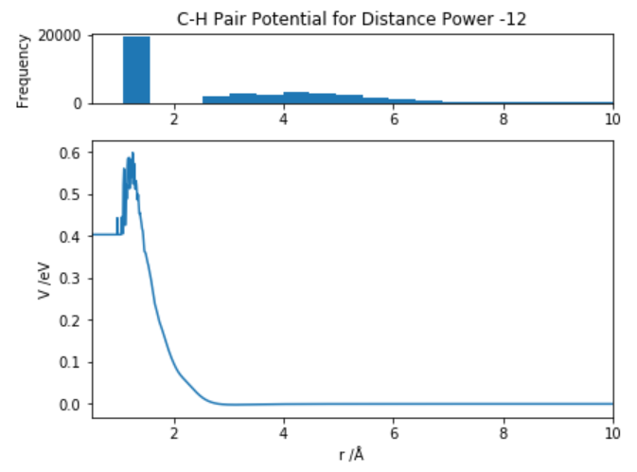
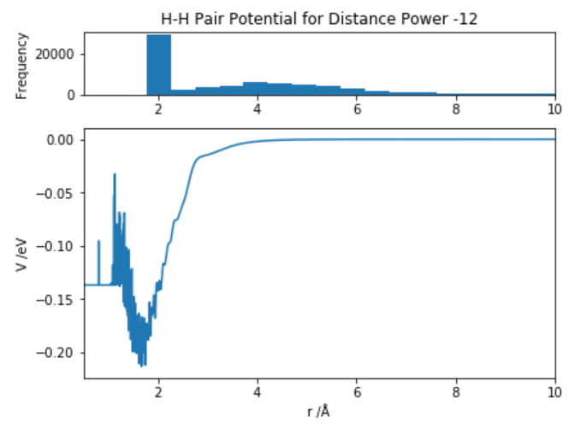
12th-Power Potentials
C-C and C-H potentials have only repulsive contributions
H-H potential has both attractive and repulsive contributions at long- and short-range
Large fluctuations caused by overfitting
Large H-H well depth of 214 meV
Figure 10 – 12th-power Potentials
Notes:
The C-C and C-H potentials contained only repulsive contributions to the total energy, whereas the H-H potential had both attractive and repulsive contributions to the total energy at long- and short-range, but was very noisy. The large fluctuations are likely to be a direct result of overfitting.

Slide 15
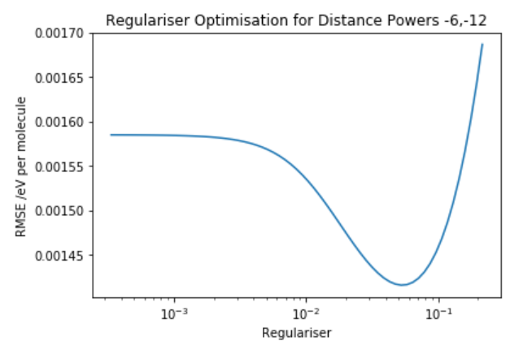
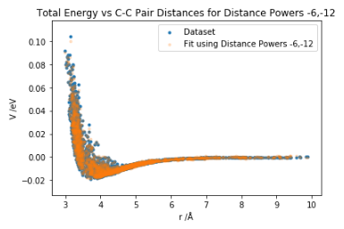
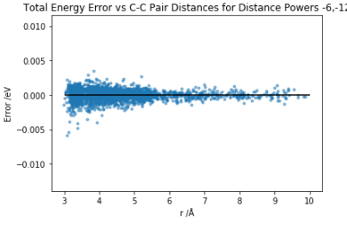
12-6 Model
6th-power and 12th-power kernels summed to give 12-6 kernel
Regulariser optimisation carried out using six-fold cross-validation, using minimum CV error of 1.42 meV per methane molecule at a regulariser of 0.0523
Figure 11 – 12-6 Optimisation
Lowest training error of 389 μeV, but slightly overfitted
Large error at short-range somewhat removed, no bias at long-range
Figure 12 – 12-6 Total Energy Plots
Notes:
I created a 12-6 model, which was an average of the 6th- and 12th-power models. The same regulariser optimisation was carried out. The optimal regulariser was found to be 0.0523, which had a minimum validation error of 1.42 meV.
This regulariser gave a low training error of 389 μeV, but given the discrepancy between the training and cross-validation errors, it is likely that the model was slightly overfitted.

Slide 16
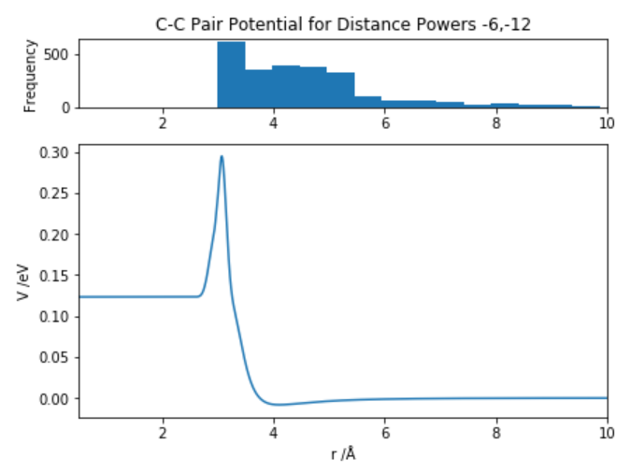
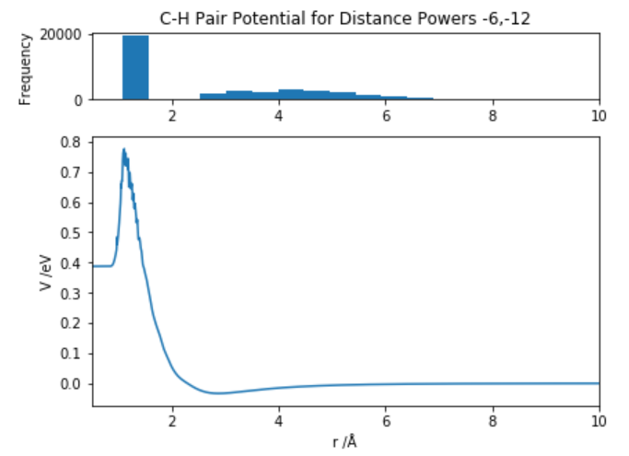
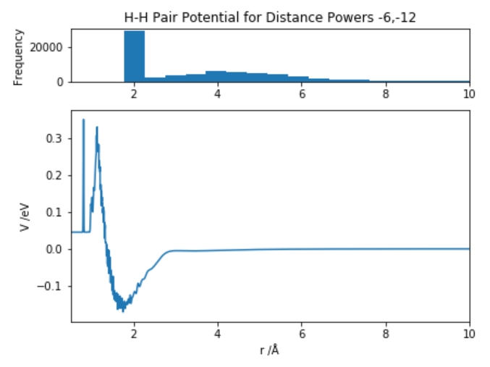
12-6 Potentials
All potentials give attractive and repulsive contributions at long- and short-range
High orders of magnitude for potential wells – 8.17 meV for C-C, 33.1 meV for C-H and 171 meV for H-H pairs
Removal of oscillations at long-range without using a shorter cut-off radius
Noise indicative of overfitting
Figure 12 – 12-6 Potentials
Notes:
All three potentials exhibited some features which were present in both the 6th- and 12th-power potentials.

Slide 17
Summary
Model | Validation Error | Training Error
Unscaled Distance | 1.15 meV | 1.02 meV
6th-Power | 1.07 meV | 863 µeV
12th-Power | 2.41 meV | 499 µeV
12-6 | 1.42 meV | 389 µeV
Table 1 – Error Comparison
Unscaled Distance Potentials computed but oscillated at long-range
Distance scaling by powers of -6 and -12 hoped to remove this
6th-power potentials held a good physical form, while 12th-power potentials were overfitted
12-6 model created by combining 6th- and 12th-power models
12-6 potentials held a reasonable physical form but with some overfitting
librascal can be used to compute GAPs using distance scaling powers
Notes:
In summary, a model using unscaled distances was created and most notably, the potentials for this model oscillated at long-range.
In order to solve this, models were created with pair distances scaled by powers of -6 and -12, as these are the powers in the L-J potential and we know that dispersion is the dominant interaction between methane molecules. The 6th-power potentials held a good physical form and provide a good option for fitting the long-range tail of intermolecular interactions. The 12th-power potentials were overfitted, and so it seems unlikely that that the short-range repulsion can be modelled well in this way.
The 12-6 model was created and its potentials held a reasonable physical form, but with some overfitting, brought about by the 12th-power model’s contribution. In general though, this is a promising and inexpensive strategy for modelling long-range interactions in systems dominated either by dispersion or other interactions by changing the scaling power.

